Slide 1
Unix Socket

Slide 2
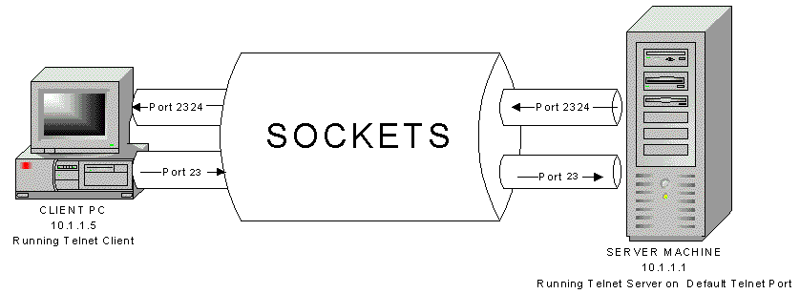
Definition
Socket is a virtual endpoint of any kind of network communication done between two hosts over in a network. Sockets can be used in many languages like Java, C++, C etc. The socket API on Linux is similar to BSD/UNIX sockets from which it has evolved.
https://medium.com/@kaveendra.oshan/socket-programming-linux-a0622da1c596

Slide 3
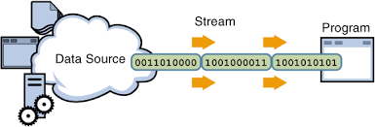
Definition
Sockets allow communication between two different processes on the same or different machines. To be more precise, it's a way to talk to other computers using standard Unix file descriptors. In Unix, every I/O action is done by writing or reading a file descriptor. A file descriptor is just an integer associated with an open file and it can be a network connection, a text file, a terminal, or something else.
www.seas.upenn.edu

Slide 4
Where is Socket Used?
Typical applications today consist of many cooperating processes either on the same host or on different hosts.
For example, consider a client-server application. How to share (large amounts of ) data?
Share files? How to avoid contention? What kind of system support is available?
We want a general mechanism that will work for processes irrespective of their location.

Slide 5
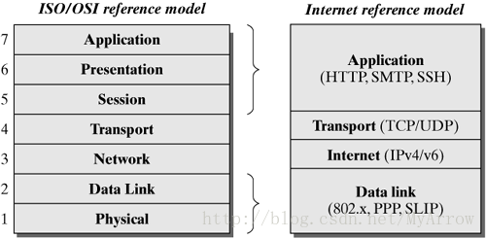
Where is Socket Used?
A Unix Socket is used in a client-server application framework. A server is a process that performs some functions on request from a client. Most of the application-level protocols like FTP, SMTP, and POP3 make use of sockets to establish connection between client and server and then for exchanging data.
Data transfer
Sharing data
Event notification
Process control

Slide 6
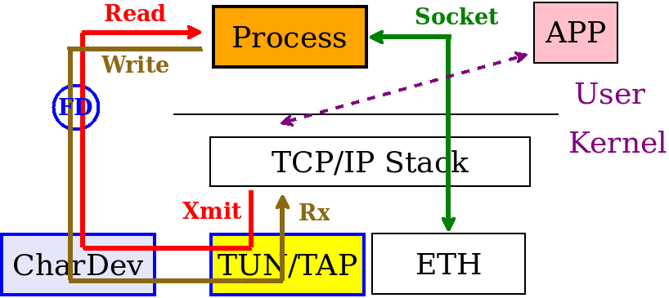
Where is Socket Used?
A Unix Socket is used in a client-server application framework. A server is a process that performs some functions on request from a client. Most of the application-level protocols like FTP, SMTP, and POP3 make use of sockets to establish connection between client and server and then for exchanging data.
https://www.google.com.ua/url?sa=i&rct=j&q=&esrc=s&source=imgres&cd=&cad=rja&uact=8&ved=2ahUKEwi6jYPy8d_bAhXCXCwKHdPlD1kQjhx6BAgBEAM&url=http%3A%2F%2Frecolog.blogspot.com%2F2016%2F06%2Ftuntap-devices-on-linux.html&psig=AOvVaw1b9ZCqUgtH7UGkF-zgLCWj&ust=1529503285840669

Slide 7
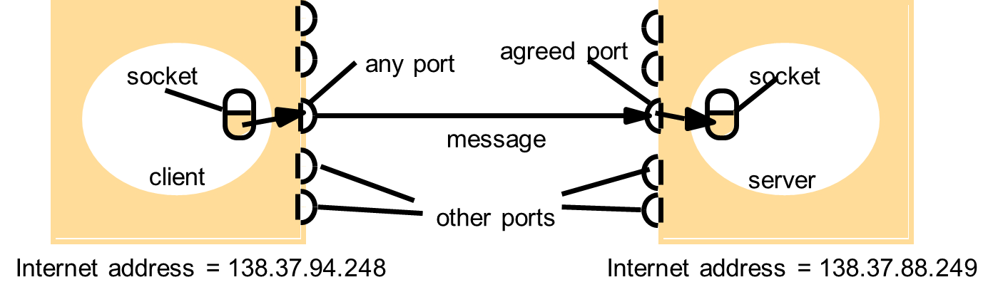
Sockets and ports
https://www.google.com.ua/url?sa=i&rct=j&q=&esrc=s&source=imgres&cd=&cad=rja&uact=8&ved=2ahUKEwi6jYPy8d_bAhXCXCwKHdPlD1kQjhx6BAgBEAM&url=http%3A%2F%2Frecolog.blogspot.com%2F2016%2F06%2Ftuntap-devices-on-linux.html&psig=AOvVaw1b9ZCqUgtH7UGkF-zgLCWj&ust=1529503285840669

Slide 8
Inter Process Communication
IP address and port number. In IPv4 about 2¹⁶ ports are available for use by user processes.
UDP and TCP abstraction of the above is a socket.
Socket is associated with a protocol.
IPC is transmitting a message between a socket in one process to a socket in another process.
Messages sent to particular IP and port# can be received by the process whose socket is associated with that IP and port#.
Processes cannot share ports with other processes within the computer. Can receive messages on diff ports.

Slide 9
Socket Names
Applications refer to sockets by name.
But within the communication domain sockets are referred by addresses.
Name to address translation is usually done outside the operating system.

Slide 10
Socket types
The format in which an address is specified is according to a domain:
AF_UNIX (address format of UNIX) - a path name within the file system,
AF_INET (internet format) : network address, port number etc.
Communication style: stream , datagram, raw or sequenced packets
Stream : reliable, error-free, connection-oriented comm.
Datagram: Connectionless, unreliable, message boundaries preserved.

Slide 11
Functions : creation
Socket creation : socket system call creates sockets on demand.
sockid = socket (af, type, protocol);
where sockid is an int,
af - address family , AF_INET, AF_UNIX, AF_AAPLETALK etc.
type - communication type:
SOCK_STREAM, SOCK_DGRAM, SOCK_RAW etc.
protocol - some domains have multiple protocol, use a 0 for your appl.
Example: door1 = socket(AF_UNIX, SOCK_DGRAM,0);

Slide 12
Functions - bind
Socket binding: A socket is created without any association to local or destination address. It is possible to bind the socket to a specific host and in it a specific port number.
socerr = bind (sockid, localaddr, addrlength)
localaddr - a struct of a specific format for each address domain;
addrlength - is the length of this struct; obtained usually by sizeof function.

Slide 13
Functions -bind (contd.)
Example: type sockaddr_un defines localaddr format for unix family.
its definition, (you don’t have to define it... it is in un.h file - include this file)
struct sockaddr_un {
short sun_family;
char sun_path[108]; };
in your program:
#define SocName “testsock”
sockaddr_un mysoc;
mysoc.sun_family = AF_UNIX;
strcpy(mysoc.sun_path, SocName);
binderr = bind(sockid, &mysoc, sizeof(mysoc));

Slide 14
Functions (contd.) - close
close (socid); closes the specified socket. This is done by a process or thread when it no longer needs the socket connection. Premature closing results in “broken pipe” error.
When a socket is created it is represented by a special file (‘s’ in the place where d appears for directory files when you ls -l).The name of the file is the name assigned in the socket bind command.

Slide 15
Functions (contd.) - connect
A socket is created in an unconnected state, which means that the socket is not associated with any destination.
An application program should call connect to establish a connection before it can transfer data thru’ reliable stream socket. For datagrams connect is not required but recommended.
connect ( sockid, destaddr, addlength);
Example: if (connect(sock, &server, sizeof(server)) < 0) ...
“sendto” command does not need “connect”

Slide 16
Functions (contd.) -sending
Five different system calls : send, sendto, sendmsg, write, writev
send, write and writev work only with connected sockets. No parameter for destination address. Prior connect should be present for communication.
Example : write (sock, DATA, sizeof(DATA));
sendto (socket, message, length, flags, destaddr, addlen);
flags allow for special processing of messages. Use 0 in your appln.
sendmsg is same as sento except that it allows for different message structure.

